Slide 1






CampusGo AI Agent
CampusGo: Your Wayfinding Buddy
Problem Statements: Student Campus Experience
Who Is It For?
Conversational Wayfinding
🌱 Freshmen
✈️ Exchange Students
CampusGo is a conversational AI agent designed to guide you exactly like a friendly upperclassman would. No complex map interfaces, no pins on an abstract drawing.
Navigating the transition and settling in without feeling lost.
Overcoming language/environmental barriers instantly.
By transforming raw geographical datasets into natural, landmarks-based step-by-step guidance, CampusGo understands where you are, what you need, and how you want to get there.
💼 Visitors & Staff
🎓 Students
Getting immediate directions to events or office spots.
Uncovering hidden gems like silent desks and study nooks.
CampusGo | Microsoft Student Ambassador AI Agent Hackathon
01

Slide 2








CampusGo AI Agent
The Campus Wayfinding Blindspot
What can our Agent Solve?
STRUCTURAL NAVIGATION GAP
Real-World Frustrations
Social Barriers & Anxiety
Building-Level Navigation
Introverted students dread stopping busy strangers or asking awkward, minor spatial questions.
Fully covered by standard GPS, excellent in finding big buildings, but not the facilities inside of them.
Effective Communication
International & exchange students struggle to articulate specific spatial queries in local languages.
Lack of Micro-Facility Navigation
Our survey show 84% of respondent who to campus have no idea where are the facilities inside those big buildings. Restrooms,study spaces, printer, or water dispenser remain completely unmapped.
Wasted Daily Productivity
Students waste valuable short breaks wandering around for a functional printer or water outlet.
CampusGo | Microsoft Student Ambassador AI Agent Hackathon
02

Slide 3

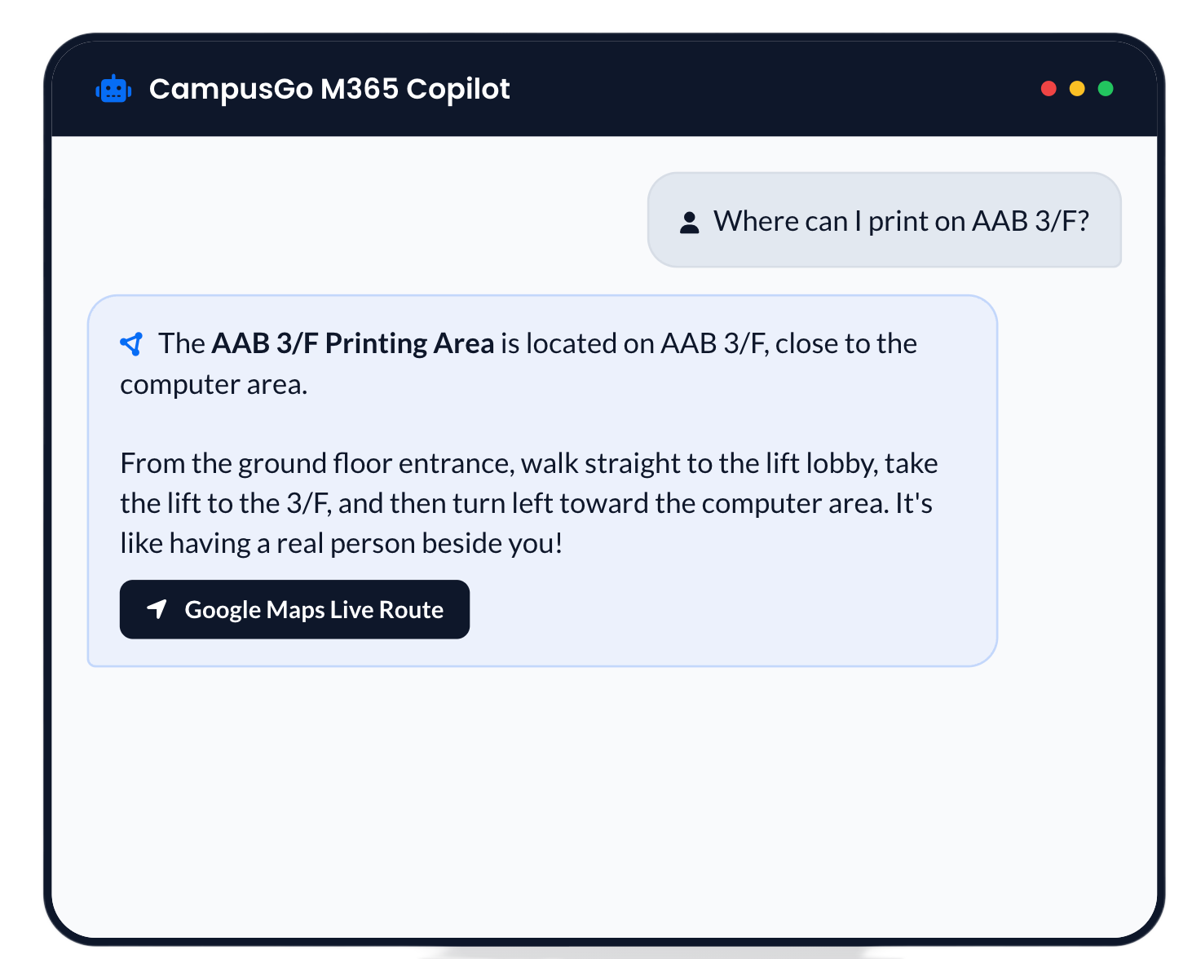
CampusGo AI Agent
Core Feature 1: Direct Facility Navigation
Uncover precise, micro-level campus assets using real-time conversational routing instructions.
Navigating the "Unmapped" Areas
Locates micro-facilities typically omitted by traditional maps (e.g. restrooms, drinking fountains, printers, specific power outlets) directly linked to local metadata.
Step-by-Step Guidance
It navigates with relational reference points and description of each step, feeling like a real personal guide by your side.
Zero-Disorientation Safeguard
Combines colloquial descriptions with marked Google map links for dual-assurance navigation. Maximizes adoption rate and provides continuous guidance reassurance.
CampusGo | Microsoft Student Ambassador AI Agent Hackathon
03

Slide 4











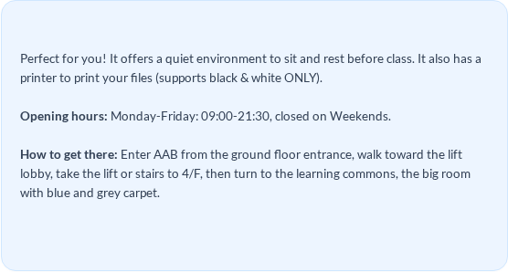
CampusGo AI Agent
Core Feature 2: Contextual Recommendation
Going beyond exact keyword queries to recommending customized places based on personal needs
CampusGo SMART INTENT (PARSES UNDERLYING NEED)
STANDARD MAP SEARCH (FAILS ABSTRACT QUERIES)
Questions like: "I have a class at AAB and wants a place to sit"
Only accepts direct questions like:"Tell me where the main library is."
CampusGo M365 Copilot
AI AGENT COGNITIVE PROCESSING PIPELINE
"I have a class at AAB and wants a place to sit."
1.
2.
3.
AAB 4 Self-Learning Area
Identify Content
Detect Needs
Understand Context
Ingest raw conversational text query.
Extract implicit intents like "waiting".
Map constraints & relative buildings.
4.
5.
6.
Match Locations
Check Constraints
Deliver Feedbacks
Google Maps Live Route to AAB
Query DB to find optimal physical nodes.
Verify operating hours & printer utility.
Compile step-by-step recommendation.
CampusGo | Microsoft Student Ambassador AI Agent Hackathon
04

Slide 5
◈
CampusGo AI Agent
How It Works: Knowledge-Grounded Guidance
A low-code Copilot Studio agent turns structured campus data into reliable, human-friendly directions.
MICROSOFT COPILOT STUDIO
✓ Published to M365 Copilot Chat
New agent experience · Low-code
USER NEED
GROUNDED GUIDANCE
“I’m in AAB. Where can I print before class?”
INSTRUCTIONS
TOOL
✓ Precise facility match
✓ Landmark-based route
✓ Context-aware answer
✓ Confirmed fallback
Persona · Location-first logic · Multilingual · Guardrails
current_Time
Checks opening hours
FACILITY KNOWLEDGE BASE
Natural-language request
DB
MVP: AAB & CVA · Schema designed for campus-wide expansion
Grounded, not guessed.
Building · Floor · Landmark · Route
Hours · Availability · Scenario · Map
Structured fields enable exact lookup, intent-based matching and human-readable indoor guidance.
CampusGo | Microsoft Student Ambassador AI Agent Hackathon
05

Slide 6






CampusGo AI Agent
Operational Feasibility & Future Vision
OUR MISSION & VISION
🔧 Feasible, Reliable & Ready to Deploy
Ensuring highly robust operations with minimal development overhead.
"CampusGo aims to maximize navigation efficiency for every soul who came to campus.
It is not just a digital map, but a friend who understands your need. Ultimately, we hope to connect thousands of users into a Crowd Marked & Shared Navigation Web”.
M365 Ecosystem
Grounded & Guardrailed
Built native within Teams and Outlook using Microsoft Copilot Studio. Zero third-party app installations required.
Prioritizes structured facility records and returns a confirmed fallback when information is incomplete.
Multi-lingual
High Portability
Native multi-language understanding backed by powerful LLM reasoning, perfect for international visitors.
Campus-wide by design. The MVP covers AAB and CVA; the same schema can scale to every campus building.
CampusGo | Microsoft Student Ambassador AI Agent Hackathon
06

